Slide 1
Medalitics
Thomas Kennedy
Aditya Ambre
Jose Barria
Chad Woodard

Slide 2
Introduction
Objective: Create a responsive, secure, hospital patient DBMS to consolidate patient information into customizable views for providers in order to make data-driven decisions about patient care and operational effectiveness
Motivation: Since the passage of the Health Information Technology for Economic and Clinical Health (HITECH) Act in 2009, nearly every healthcare organization now uses a digital patient data management system.¹
Goals:
Doctors and hospitals can access patient records to increase efficiency and effectiveness by reducing redundancy
Database is scalable and expandable to include additional hospitals, additional services such as insurance and finance information, and features such as lab results
Enable the use analytics to look for trends among demographics, regions, and certain diseases to make treatments more effective, available, and affordable

Slide 3
Top Healthcare DBMS Problems from Literature Review
 | Source References
Issue | 1 | 2 | 3 | 4 | 5
Security and Regulatory Compliance | X | X | X | X | X
Predictive Analytics and Workflow Integration | X |  | X |  | X
Data Silos |  |  | X | X
File Updating |  | X |  | X
Operational Analytics | X |  |  |  | X
Staffing |  |  | X |  | X
Data Growth |  |  |  | X
File Retrieval |  | X
Mobile Computing | X

Slide 4
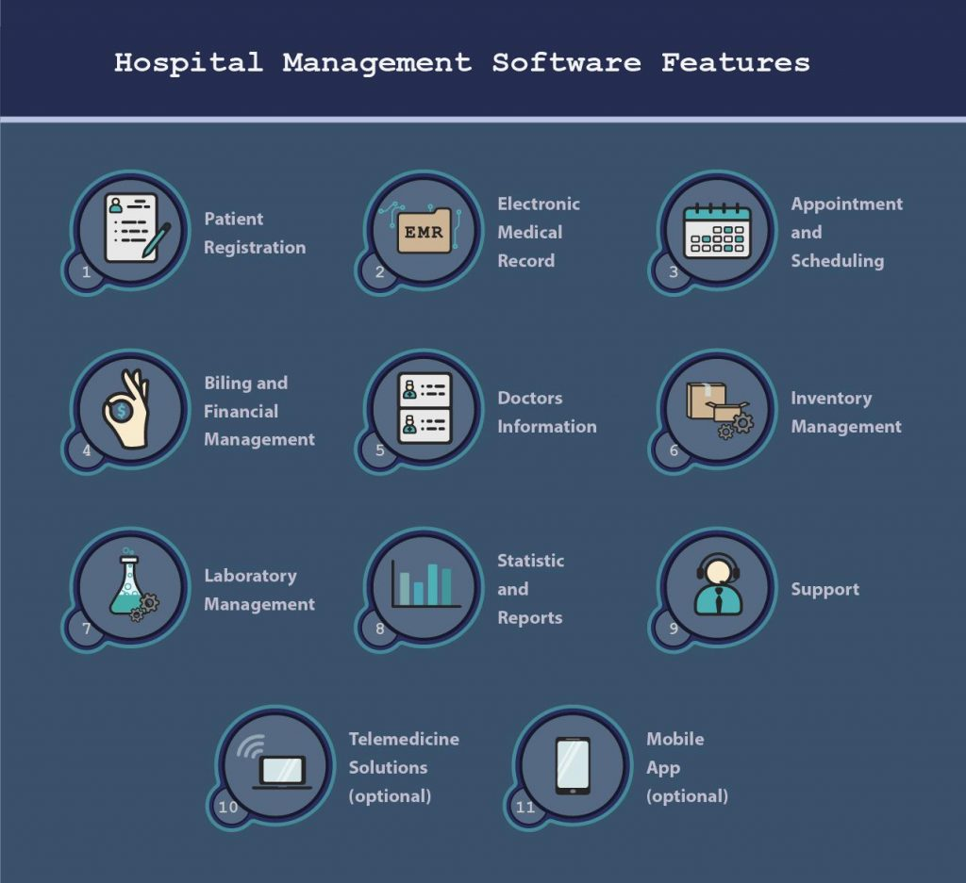
Essential Features in HMS⁸
Legend
Medalitics Phase 1
Medalitics Phase 2

Slide 5
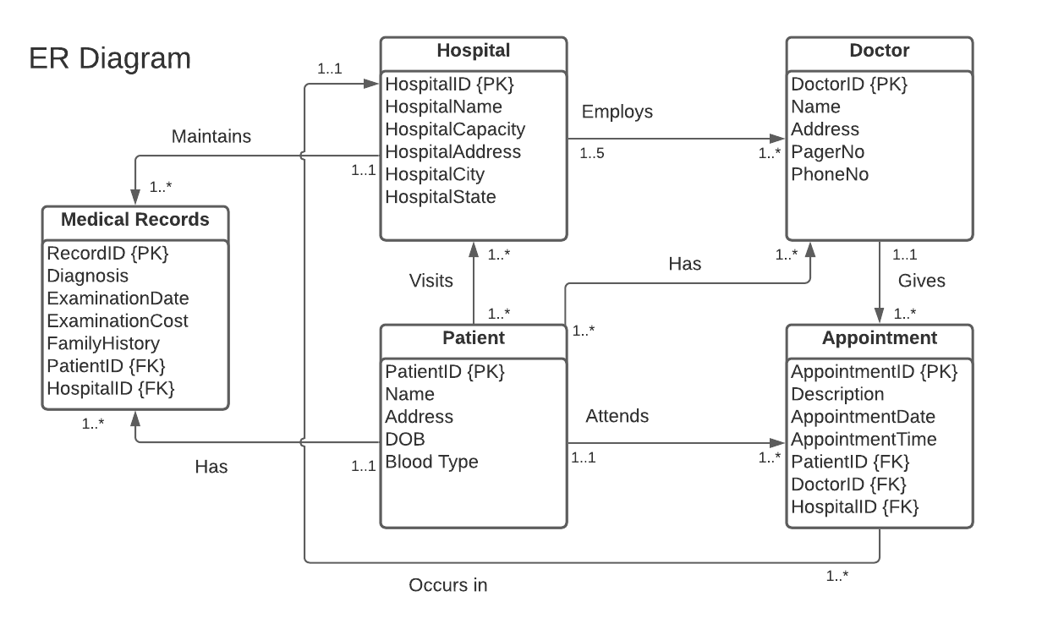

Slide 6
Dependency Diagram
Dependency preservation property enables us to enforce a constraint on the original relation by enforcing some constraint on each of the smaller relations.
Determinant | → | Functional Dependency
HospitalID | → | (Hospital) Name, Capacity, Address, City, State
DoctorID | → | (Doctor) Name, Address, PagerNo, PhoneNo
AppointmentID | → | Description, ApptDate, ApptTime, PatientID, DoctorID
PatientID | → | (Patient) Name, Address, DOB, Blood Type
RecordID | → | Diagnosis, ExamDate, ExamCost, FamilyHistory, PatientID, HospitalID

Slide 7
Normalization
Relationships that are 1..* both ways for hospital, patient, and doctor
Functional dependencies when going to first normal form to second normal form
No transitive dependencies so nothing is changed from second to third normal form
Three additional tables were added: Patient-Hospital, Doctor-Hospital, and Patient-Doctor
End result of 8 normalized tables

Slide 8
Tables with Populated Data:
Hospital, Patient
pID | pName | pAddress | pDOB | pBloodType
603L | Jimenez | 989 Elmwood St. | 4/5/1998 | A-
422M | Giles | 929 Creekside St. | 10/9/1980 | O+
60H | Eaton | 7781 Gregory Ave. | 8/23/1985 | B+
938F | Yates | 9350 Van Dyke St. | 12/28/1995 | A+
430A | Mooney | 37 Pawnee Street | 4/28/2000 | B-
680V | Gay | 163 E. Plymouth Lane | 10/24/1984 | O-
899O | Harmon | 11 Randall Mill St. | 3/11/1994 | AB+
35U | Mccullough | 8016 W. Greenrose Ave. | 4/27/1973 | AB-
888P | Miller | 542 Armstrong St. | 3/29/1984 | A-
220D | Yang | 8348 Beechwood Ave. | 1/1/1979 | O+
621K | Case | 72 Purple Finch St. | 5/31/1971 | B+
249G | Baxter | 6 St Margarets Street | 5/8/1995 | A+
689N | Heath | 76 North Pin Oak St. | 3/14/1975 | B-
483J | Buchanan | 41 Queen St. | 7/27/1980 | O-
922S | Peck | 413 Clay Lane | 1/6/1975 | AB+
836B | Barrett | 66 University Street | 11/7/1990 | AB-
412T | Burgess | 80 King Court | 6/6/1994 | A-
719C | Mccoy | 80 SW. Bay St. | 11/24/1991 | O+
337I | Rodriguez | 611 Manhattan Street | 12/25/2000 | B+
188E | Campbell | 9921 South Sunnyslope Ave. | 8/28/1999 | A+
hID | hName | hCapacity | hAddress | hCity | hState
448 | St Mary | 5000 | 2nd St | Birmingham | AL
931 | St Jude | 4500 | 1st St | Anaheim | CA
486 | Providence | 4000 | 4th Ave | White Sands | NM
350 | First Med | 500 | 218 St S | Albany | NY
660 | Second Med | 500 | 480 N Chandler | Atlanta | GA
649 | Urgent Care | 50 | 111 Main St | El Paso | TX
156 | Quick Med | 20 | 29 West Blvd | Norman | OK
531 | TriCare | 100 | 0 Alamo Way | Dallas | TX
596 | TriCare South | 150 | 323 Park Pl | Houston | TX
798 | Northwest Med | 900 | 512 Glacier Rd | Spokane | WA

Slide 9
Tables with Populated Data:
Doctor, Doctor-Hospital, Patient-Hospital, Patient-Doctor
pID | hID
603L | 448
422M | 486
60H | 660
938F | 448
430A | 931
680V | 486
899O | 350
35U | 660
888P | 649
220D | 156
621K | 531
249G | 596
689N | 798
483J | 448
922S | 931
836B | 486
412T | 350
719C | 660
337I | 531
188E | 596
422M | 798
680V | 649
220D | 156
922S | 531
337I | 596
483J | 798
pID | dID
603L | 4912
422M | 2317
60H | 3507
938F | 5530
430A | 1543
680V | 5112
899O | 3381
35U | 9351
888P | 6269
220D | 9035
621K | 2317
249G | 3749
689N | 4912
483J | 2317
922S | 3507
836B | 5530
412T | 1543
719C | 3381
337I | 9351
188E | 3381
422M | 6269
680V | 9035
220D | 5110
922S | 5110
337I | 4912
483J | 5112
dID | hID
4912 | 448
2317 | 486
3507 | 660
5530 | 448
1543 | 931
5112 | 486
3381 | 350
9351 | 660
6269 | 649
9035 | 156
2317 | 531
3749 | 596
4912 | 798
2317 | 448
3507 | 931
5530 | 486
1543 | 350
3381 | 660
9351 | 531
3381 | 596
6269 | 798
9035 | 649
dID | dName | dAddress | pagerNo | phoneNo
4912 | Novak | 9050 Westminster St. | (404) 408-9963 | (866) 779-7571
2317 | Bowers | 9398 Main Dr. | (859) 709-6828 | (845) 533-8450
3507 | Christian | 513 Cedar Swamp St. | (642) 211-1114 | (663) 438-5332
5530 | Shepherd | 77 North Briarwood Ave. | (493) 739-0738 | (573) 342-2112
1543 | Dunlap | 186 Crescent Drive | (622) 842-6754 | (593) 215-6192
5112 | Oneill | 7564 Sutor Street | (696) 519-7680 | (714) 575-1641
3381 | Mueller | 7640 Trout Dr. | (223) 529-6831 | (992) 979-9452
9351 | Mcintyre | 85 Queen St. | (478) 715-6391 | (555) 558-6488
6269 | Johnson | 7294 King St. | (334) 470-0929 | (485) 410-2836
9035 | Gregory | 90 Marsh Rd. | (731) 345-6827 | (823) 494-0243
5110 | Goodwin | 168 Brandywine St. | (636) 342-4676 | (571) 793-8499
3749 | Ryan | 338 Trusel Rd. | (573) 458-4699 | (374) 315-7029

Slide 10
Tables with Populated Data:
Appointment
aID | aDescription | aDate | aTime | pID | dID
2561 | Physical | 1/26/2022 | 9:25:00 AM | 719C | 3381
2562 | Physical | 12/13/2021 | 1:00:00 PM | 337I | 9351
2563 | Surgery | 12/14/2021 | 11:55:00 AM | 188E | 3381
2564 | Routine | 1/27/2022 | 4:55:00 PM | 422M | 6269
2565 | Physical | 1/12/2022 | 11:20:00 AM | 680V | 9035
2566 | Routine | 1/25/2022 | 1:45:00 PM | 220D | 5110
2567 | Lab work | 1/21/2022 | 9:10:00 AM | 922S | 5110
2568 | Lab work | 1/13/2022 | 11:15:00 AM | 337I | 4912
2569 | Surgery | 1/6/2022 | 2:50:00 PM | 483J | 5112
2570 | Routine | 1/14/2022 | 10:40:00 AM | 422M | 2317
2571 | Routine | 1/3/2022 | 1:30:00 PM | 60H | 3507
2572 | Physical | 1/11/2022 | 1:55:00 PM | 938F | 5530
2573 | x-Ray | 12/22/2021 | 2:15:00 PM | 430A | 1543
2574 | Routine | 1/20/2022 | 3:40:00 PM | 680V | 5112
2575 | x-Ray | 12/21/2021 | 9:50:00 AM | 899O | 3381
2576 | Lab work | 1/5/2022 | 5:00:00 PM | 35U | 9351
2577 | Surgery | 12/15/2021 | 9:15:00 AM | 888P | 6269
2578 | x-Ray | 12/31/2021 | 4:30:00 PM | 220D | 9035
2579 | Lab work | 1/7/2022 | 4:50:00 PM | 621K | 2317
2580 | x-Ray | 12/24/2021 | 12:40:00 PM | 249G | 3749

Slide 11
Tables with Populated Data:
Records
rID | diagnosis | examDate | examCost | famHistory | pID | hID
21985 | Nondisplaced fracture of neck of other metacarpal bone | 10/13/2020 | $ 4,277.45 | Osteoporosis | 249G | 596
21986 | Placenta previa with hemorrhage, second trimester | 10/16/2020 | $ 1,023.34 | None | 689N | 798
21987 | Laceration with foreign body of right ring finger with damage to nail | 10/21/2020 | $ 1,197.89 | None | 483J | 448
21988 | Other spotted fevers | 10/22/2020 | $ 6,719.26 | Cancer | 922S | 931
21989 | Altered mental status, unspecified | 10/29/2020 | $ 4,300.41 | Depression | 836B | 486
21990 | Traumatic rupture of unspecified ligament of right little finger at metacarpophalangeal and interphalangeal joint | 11/2/2020 | $ 4,584.85 | Diabetes | 412T | 350

Slide 12
SQL Commands with Screenshot
VIEWS:

Slide 13
Works Cited
“The Top Six Challenges of Healthcare Data Management.” Ingrammicro.Com, https://imaginenext.ingrammicro.com/data-center/the-top-six-challenges-of-healthcare-data-management. Accessed 20 Oct. 2021.
Amaechi James C., Agbasonu Valerian C., and Nwawudu Sixtus E. “Design and Implementation of a Hospital Database Management System (HDMS) for Medical Doctors.” International Journal of Computer Theory and Engineering, vol. 10, no. 1, Feb. 2018, doi:10.7763.
Bresnick, Jennifer. “How Big Data Analytics Underpins Every Healthcare Trend.” Healthitanalytics.com, 31 July 2017, https://healthitanalytics.com/news/how-big-data-analytics-underpins-every-healthcare-trend.
MediQuant. “Health Care Data Management: 5 Ways to Overcome Its Major Challenges.” Mediquant.Com, 22 Jan. 2021, https://www.mediquant.com/health-care-data-management-5-ways-to-overcome-its-major-challenges/.
“Data Management in Healthcare: Challenges and Opportunities.” Clicdata.Com, 3 July 2019, https://www.clicdata.com/blog/data-management-in-healthcare-challenges-and-opportunities/.
HIPAA Journal. “What Are the Penalties for HIPAA Violations?” Hipaajournal.Com, 15 Jan. 2021, https://www.hipaajournal.com/what-are-the-penalties-for-hipaa-violations-7096/.
“Best Hospital Management Software.” Capterra.com, https://www.capterra.com/hospital-management-software/
Bogdan, Mykhailo. “How to Develop a Hospital Management System.” Kindgeek.Com, 12 Dec. 2019, https://kindgeek.com/blog/post/how-to-develop-a-hospital-management-system.
LucidChart. https://lucidchart.com/

